Slide 1
Centre of relief and development
Kristina Ambrožová, Executive Director

Slide 2
Who we are?
Center of Relief and Development (CRD) is the global development and aid branch of Diaconia of the Evangelical Church of Czech Brethren (Diaconia ECCB).
Diaconia ECCB has around 30 Centers in the Czech Republic
CRD was established in 2011 and since then it is based in Prague, Czech Republic.
www.diakoniespolu.cz
2

Slide 3
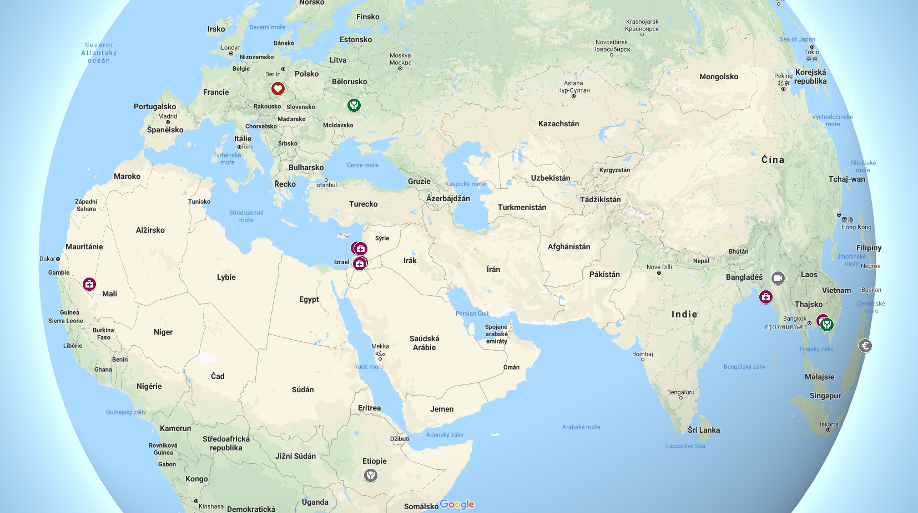
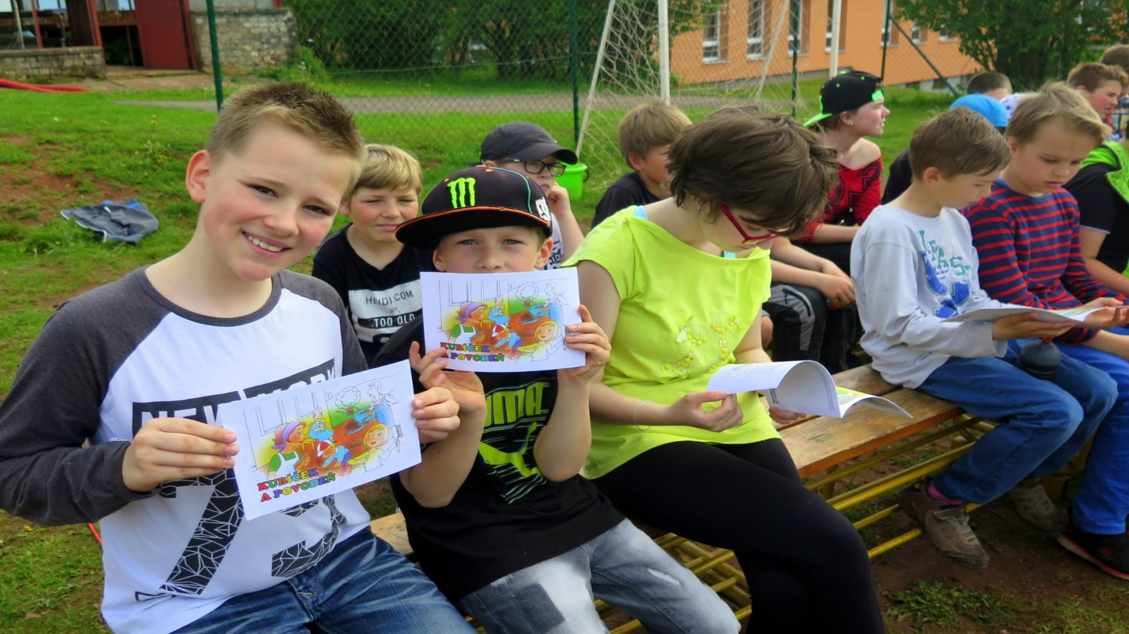
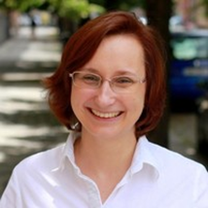
Preventivní programy na školách
Školení dobrovolníků
Prevence proti povodním, Česká republika
Jarmila Dvořáková Kamila Šimková
www.diakoniespolu.cz
3

Slide 4
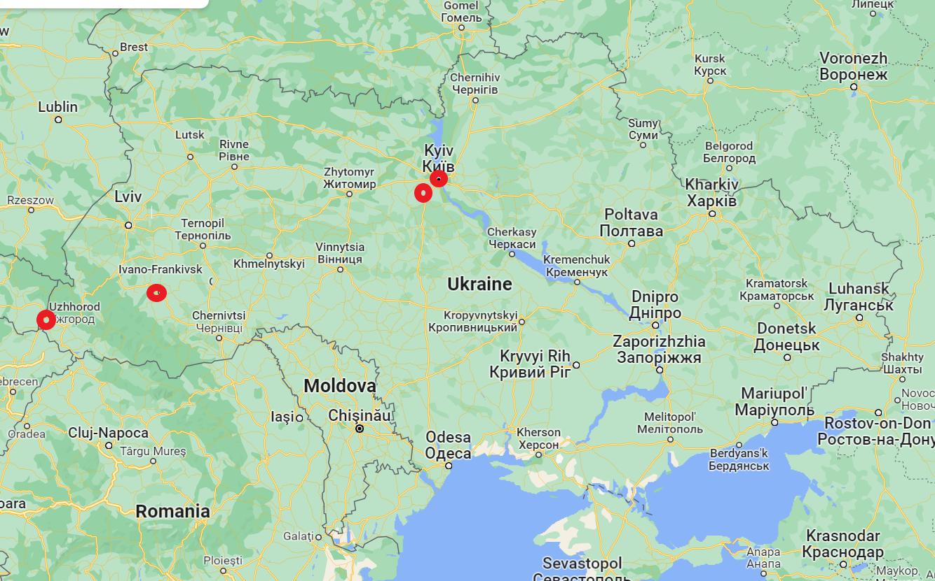

Slide 5
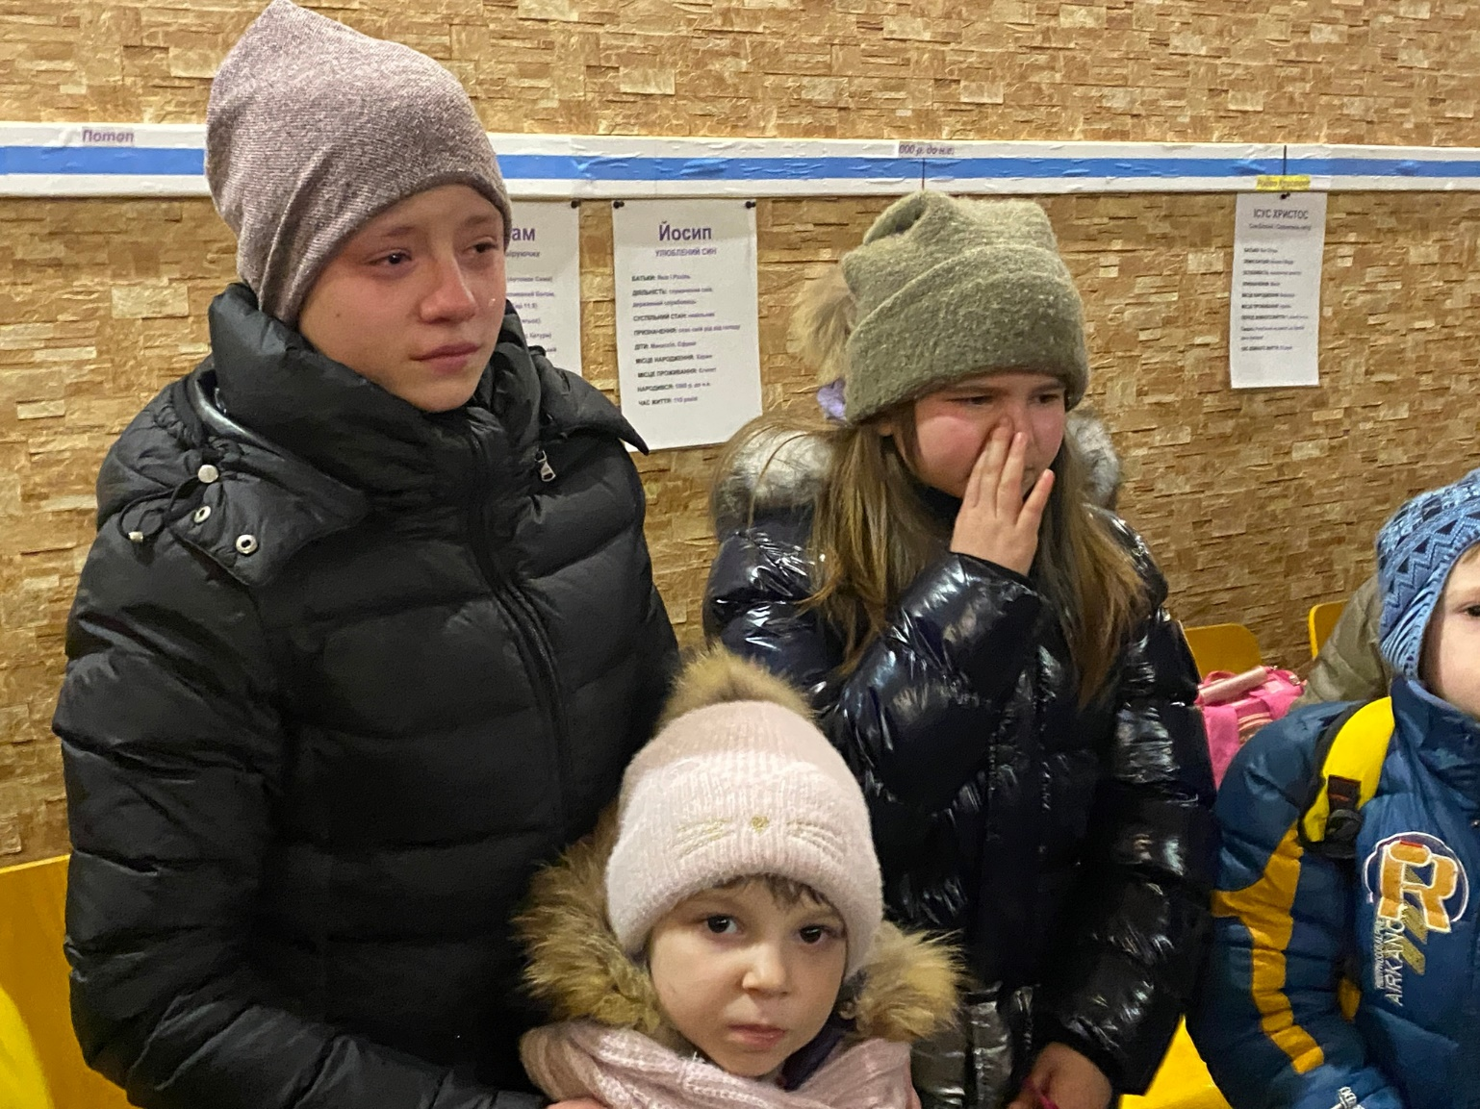
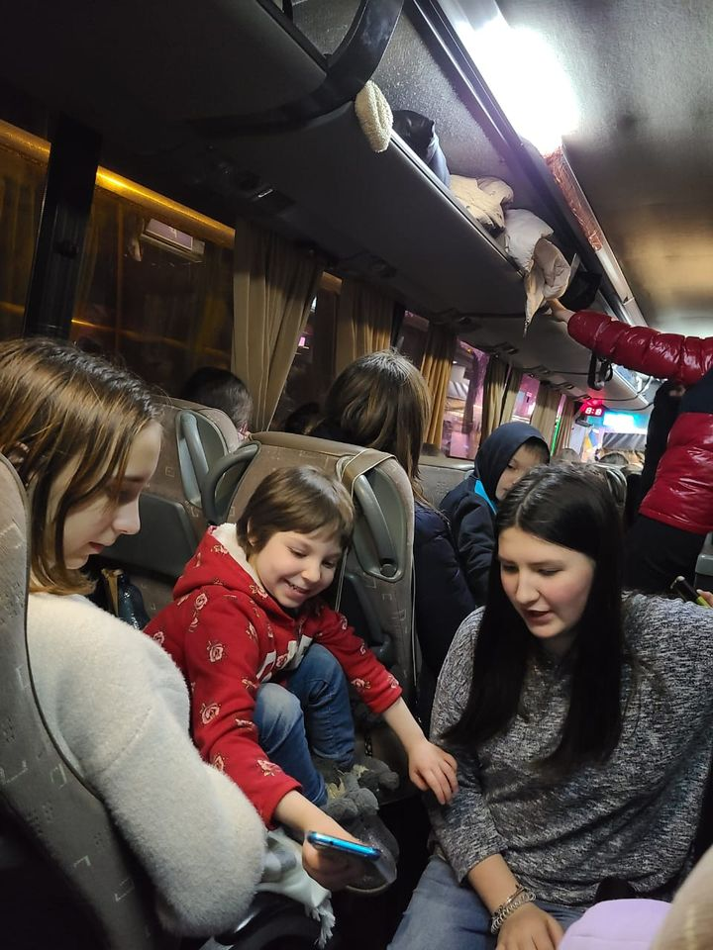
Father‘s House – Foster Care, Kyiv
160 kids evacuated to Freiburg in Germany
www.diakoniespolu.cz
5

Slide 7
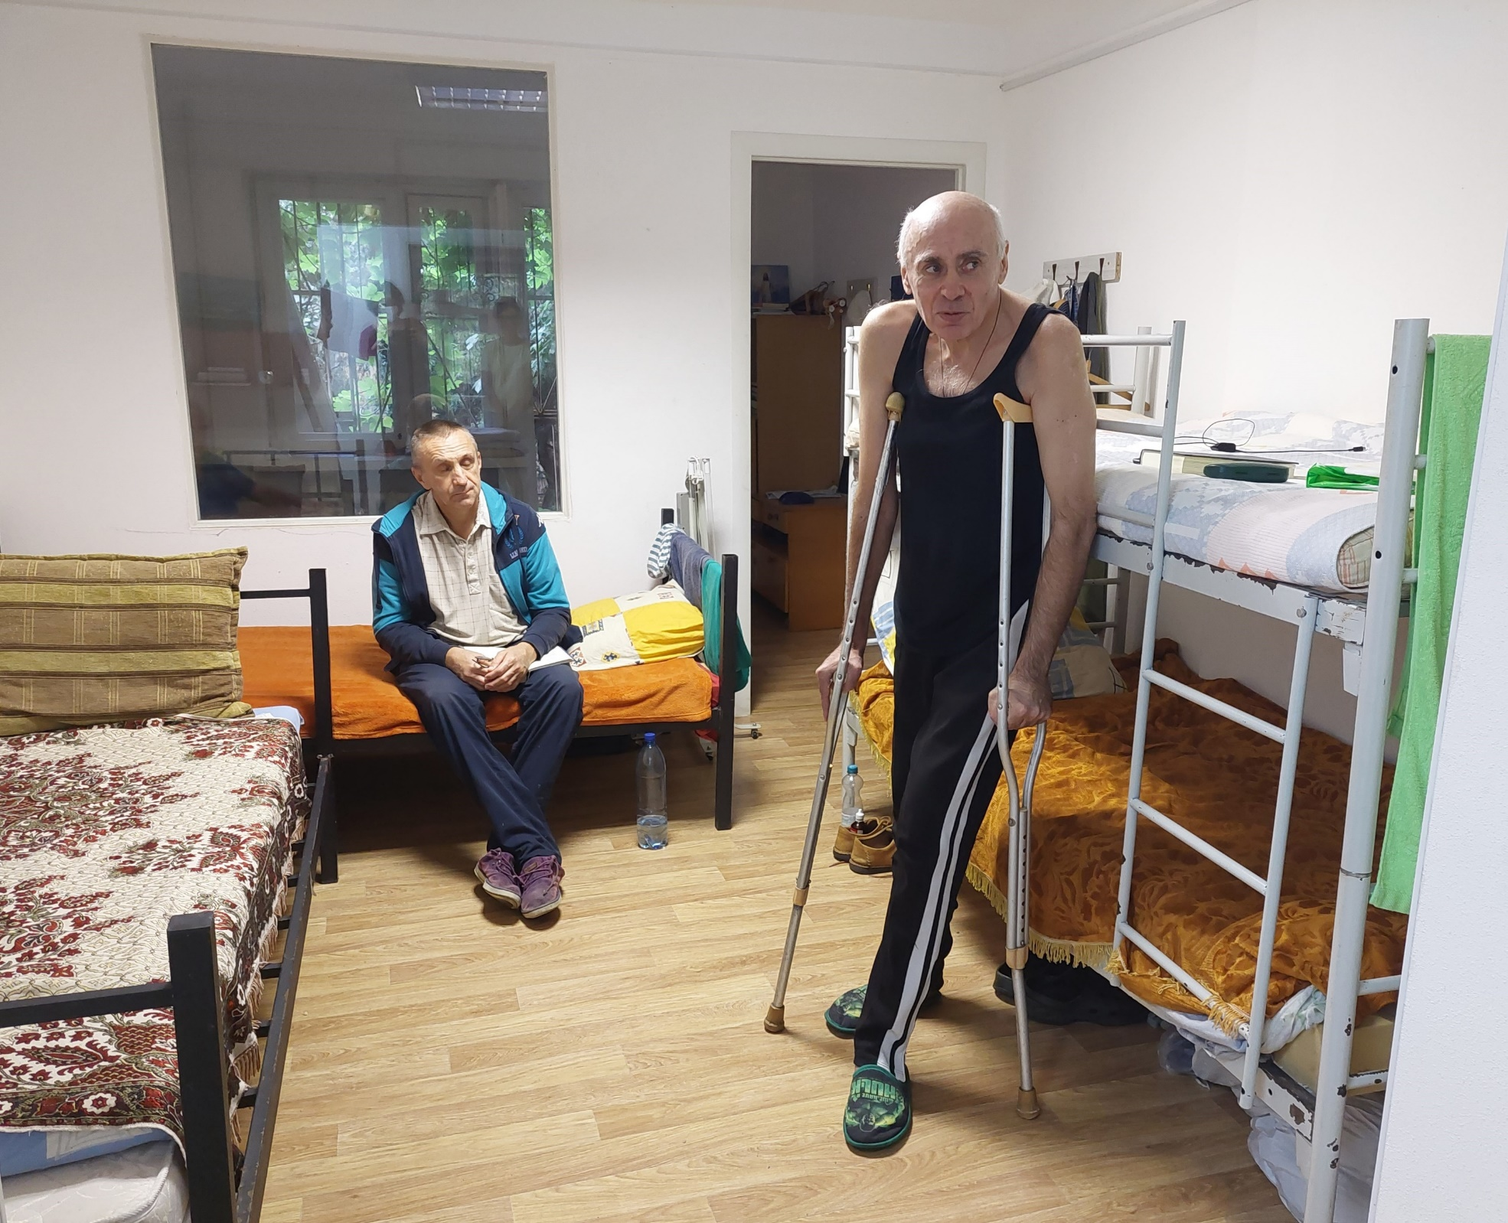
House of Mercy
Shelters for homeless people in Kyiv and surroundings
Helping people to get back to normal life – documents, social wages, employment
www.diakoniespolu.cz
7

Slide 8
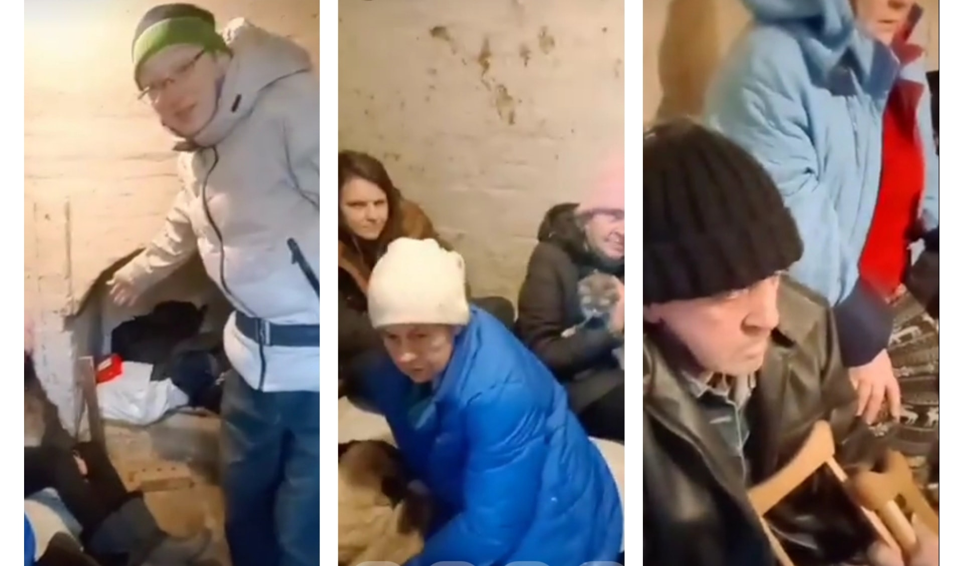
House of Mercy
Hiding in shelters in Kyiv
www.diakoniespolu.cz
8

Slide 9
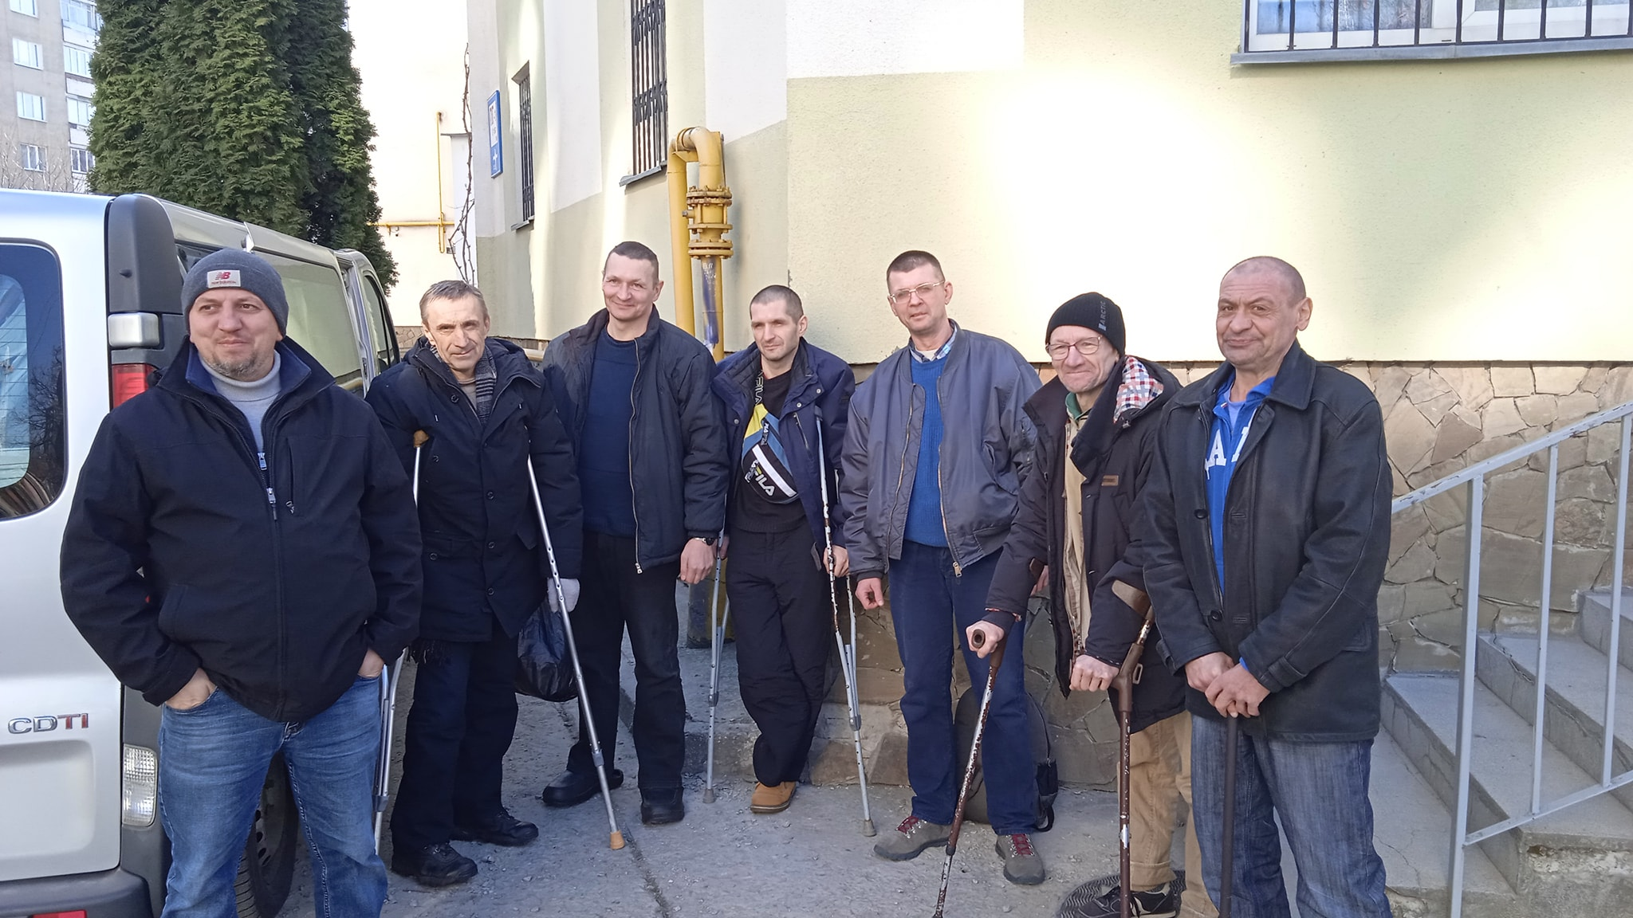
House of Mercy - leaving to Ivano-Frankovsk region
www.diakoniespolu.cz
9

Slide 10
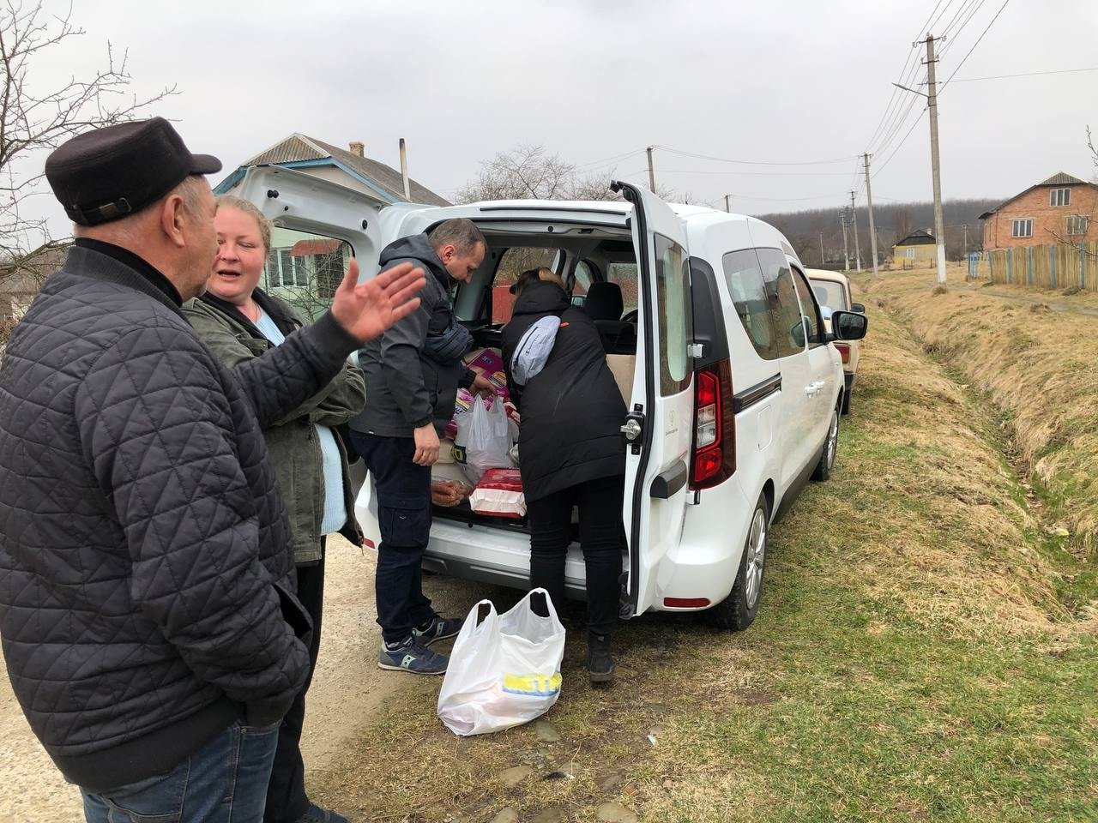
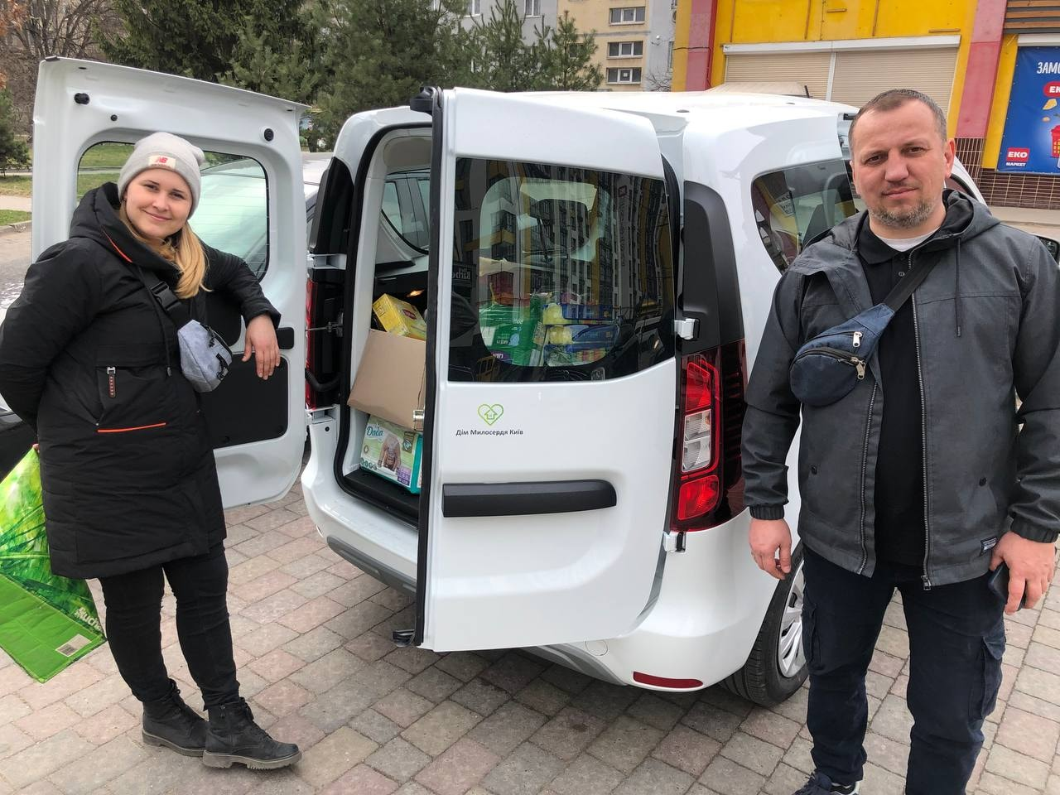
House of Mercy
Ready to provide humanitarian support in Ivano-Frankovsk region
www.diakoniespolu.cz
10

Slide 11
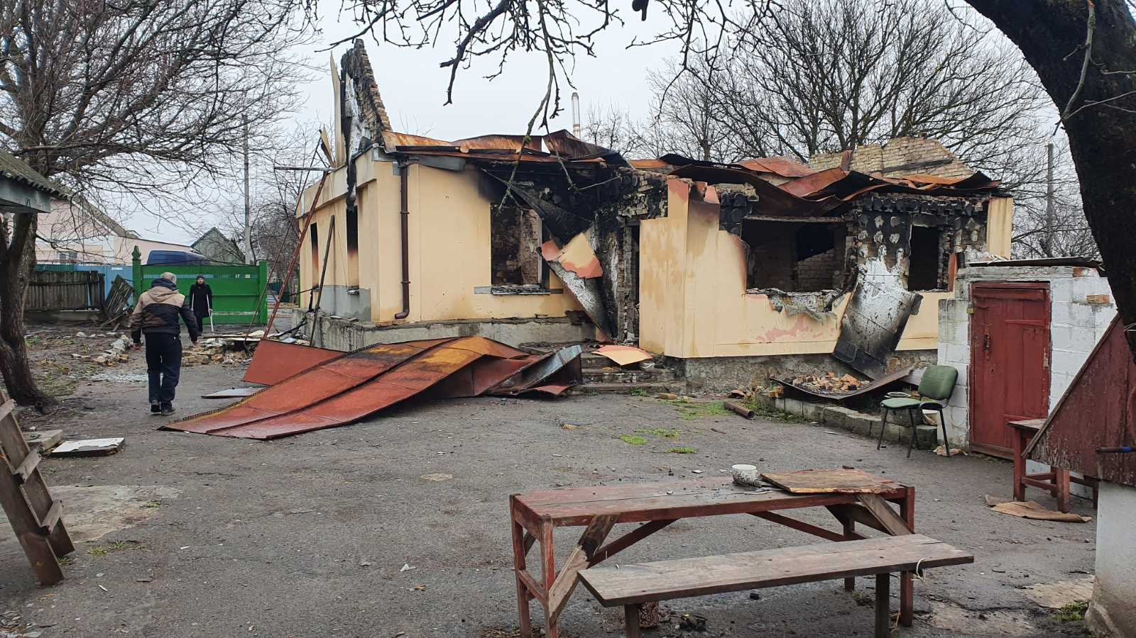
Village of Andriivka, close to Kyiv –
completely destroyed, shelter for homless woman destroyed, 1 woman died, rest is being evacuated to western part of Ukraine
www.diakoniespolu.cz
11

Slide 12
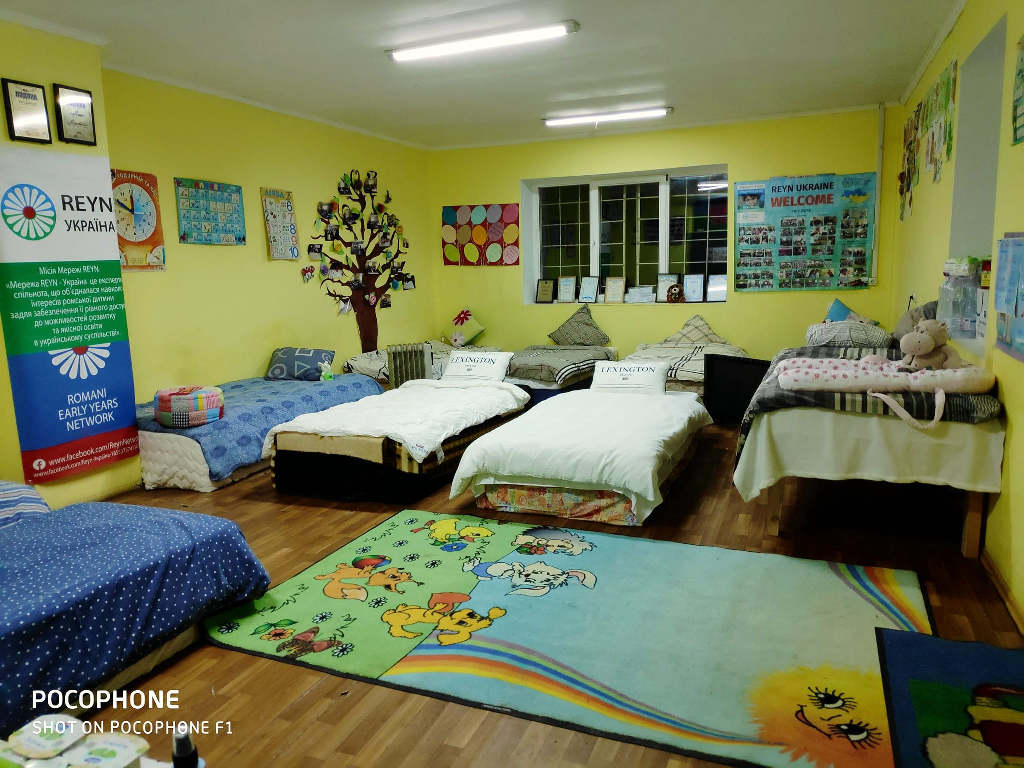
Blago Foundation
Taking care of Roma minority in Transcarpatian Region
Now accommodating around 150 IDP and refugees
www.diakoniespolu.cz
12

Slide 13
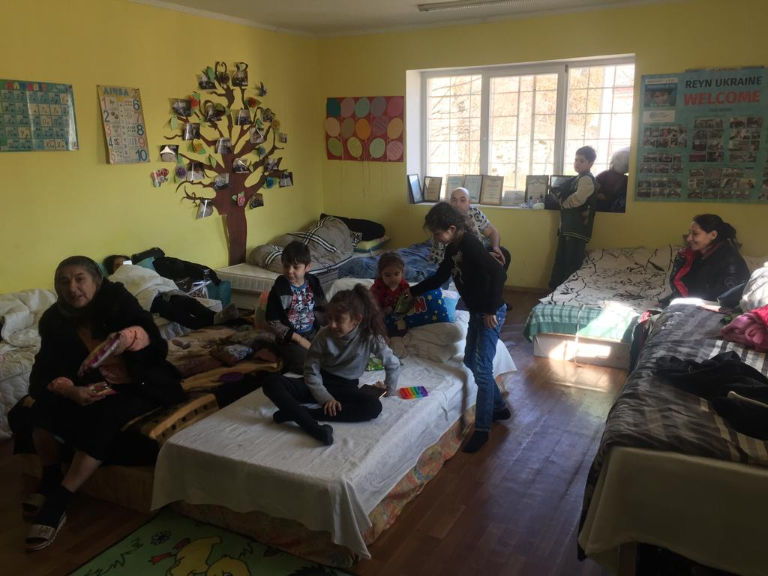
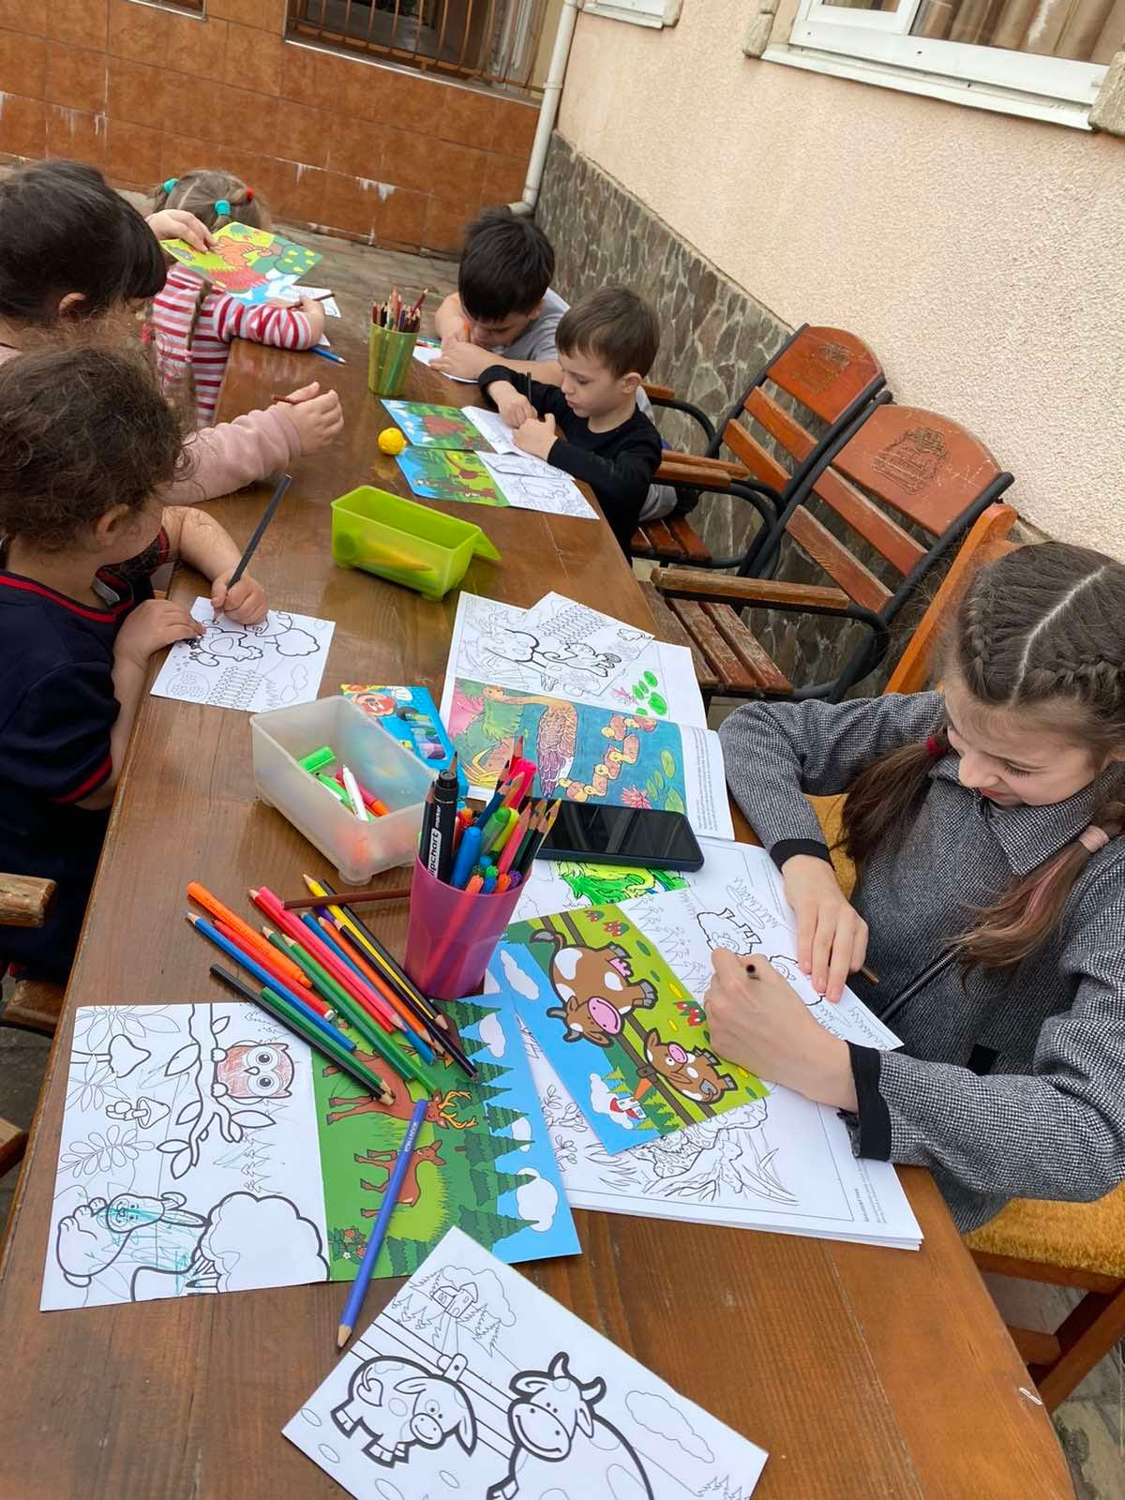
Blago Fundation
www.diakoniespolu.cz
13

Slide 14
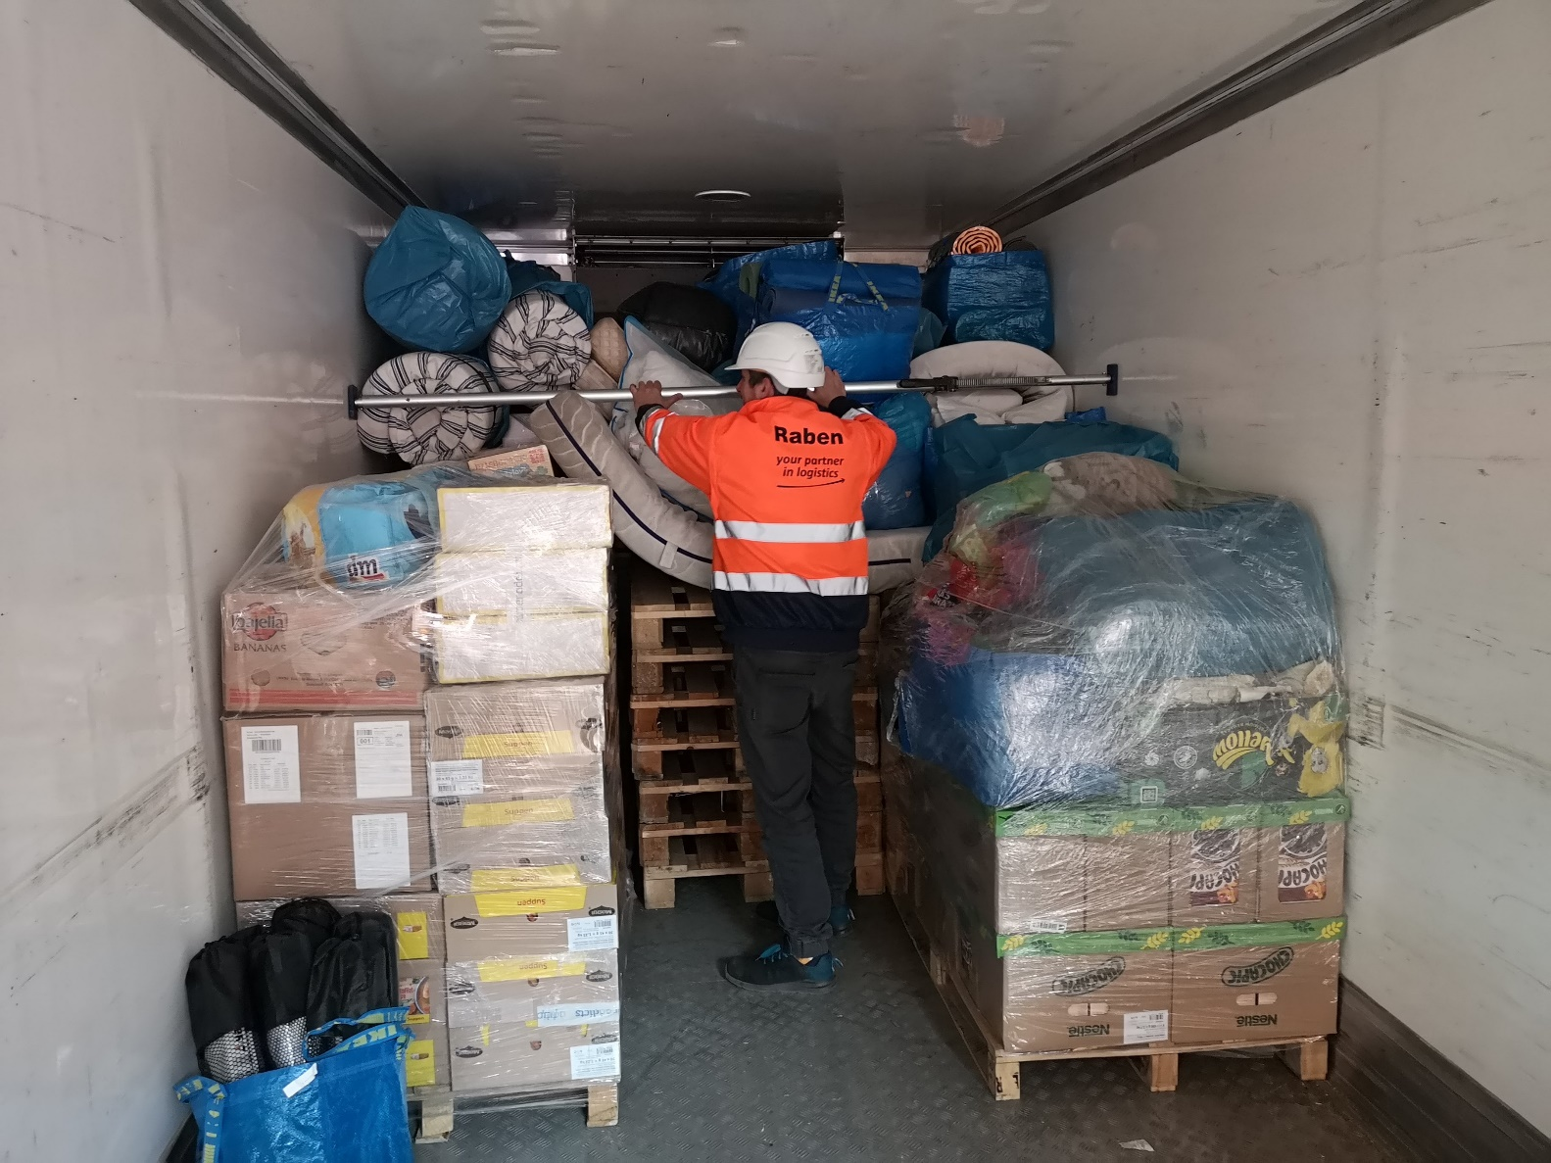
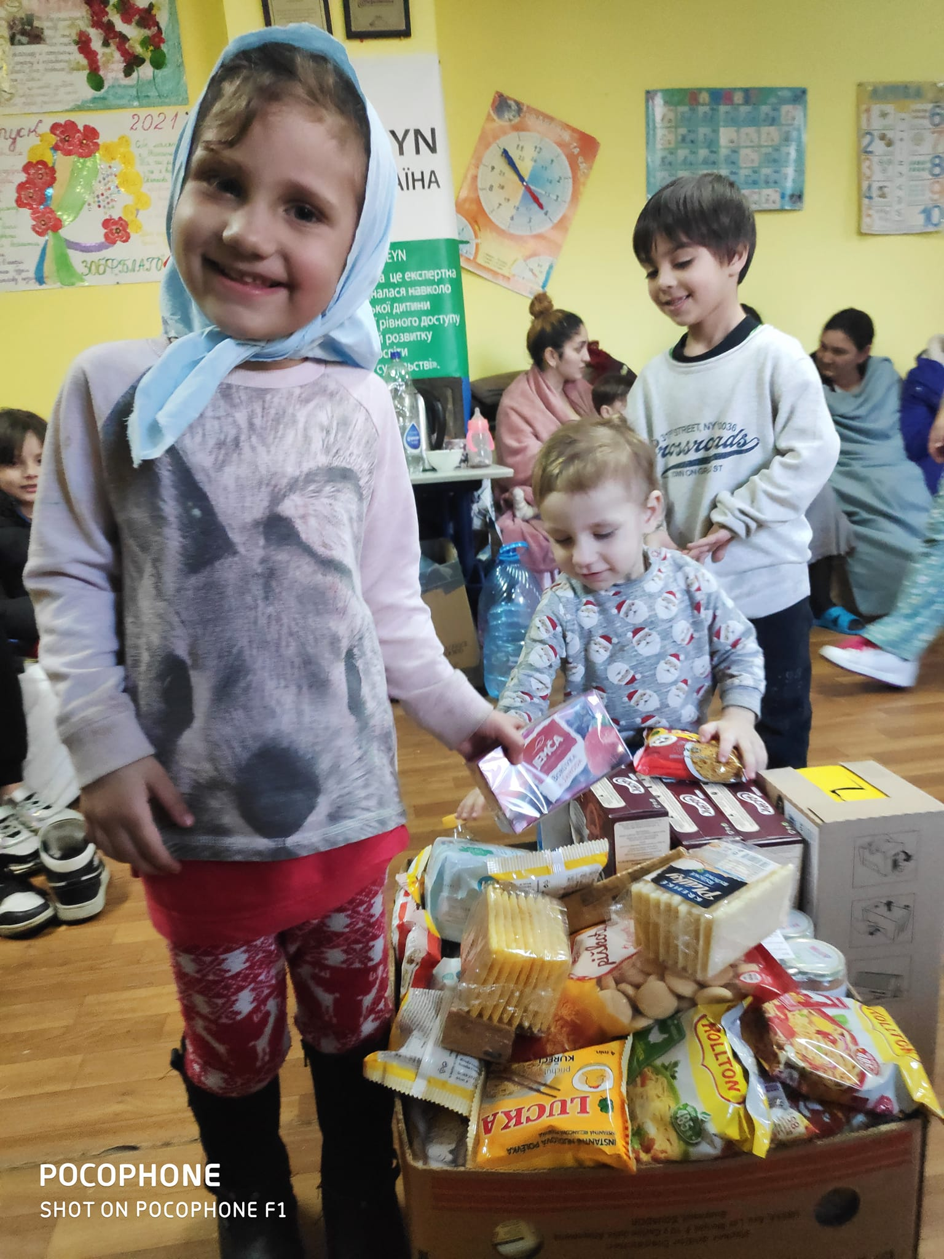
Blago Fundation
Material support from Diaconia ECCB and ECCB congregations
www.diakoniespolu.cz
14

Slide 15
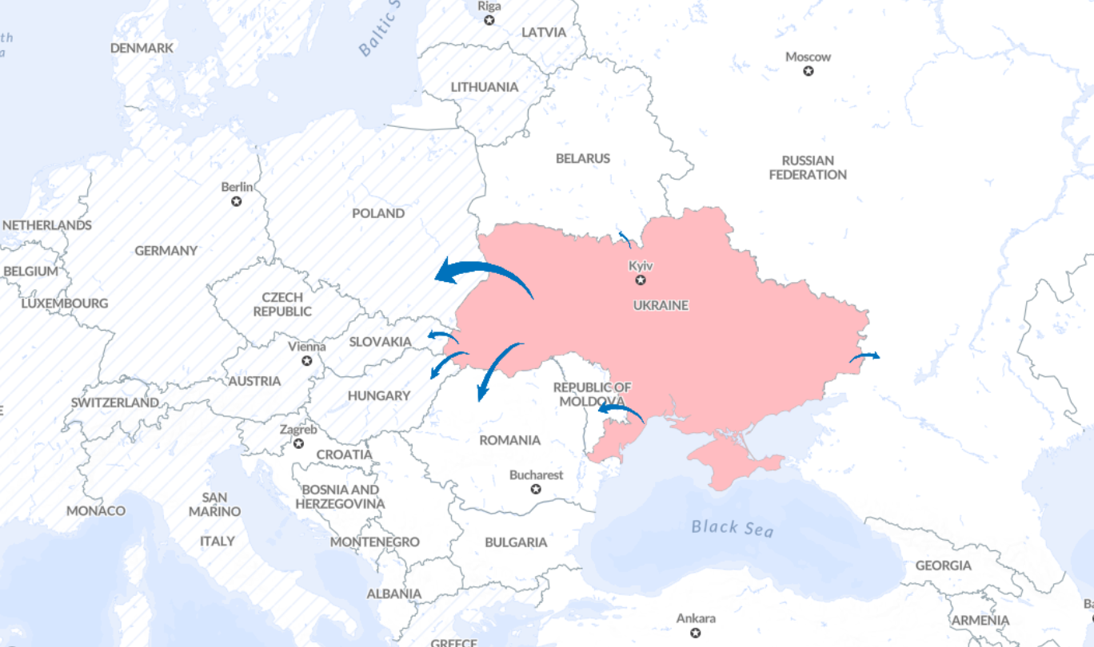
Where did Ukrainian refugees flee to
Total number of Ukrainians fleeing outside of Ukraine according to UNHCR:
4,137,842
www.diakoniespolu.cz
15

Slide 16
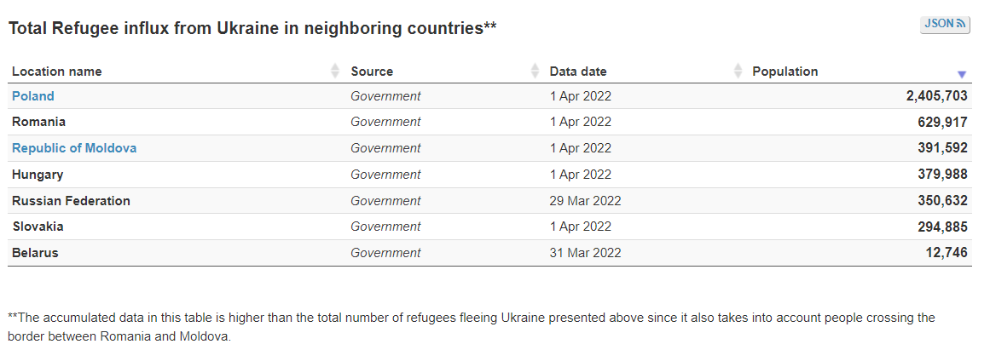
Where did Ukrainian refugees flee to – neighboring countries
www.diakoniespolu.cz
16

Slide 17
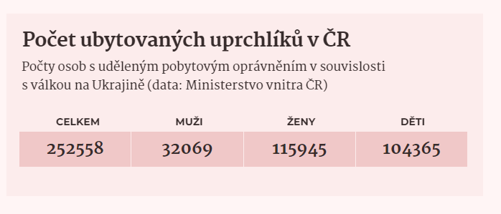
Refugees in the Czech Republic
Number of refugees registered in the Czech Republic in connection with the war in Ukraine
Total | Men | Women | Children
www.diakoniespolu.cz
17

Slide 18
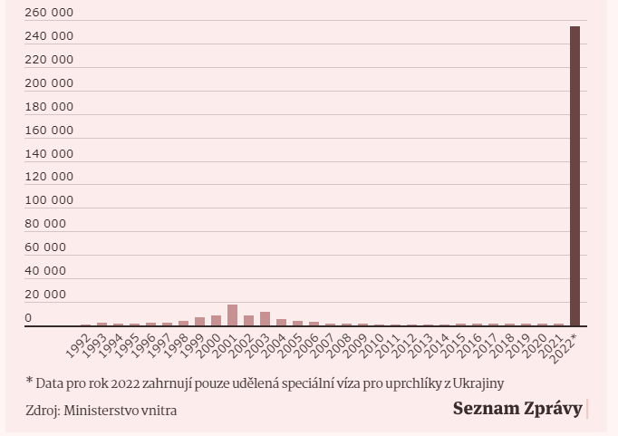
Refugees in the Czech Republic
Number of asylum requests in the Czech Republic
www.diakoniespolu.cz
18

Slide 19
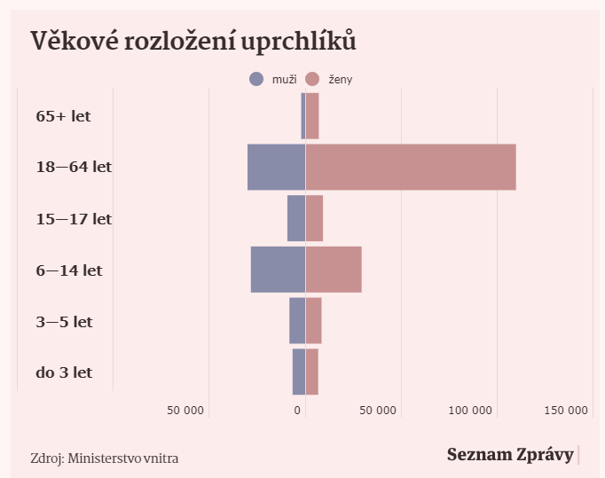
Refugees in the Czech Republic
Ukrainian refugees according to age
men
women
www.diakoniespolu.cz
19

Slide 20
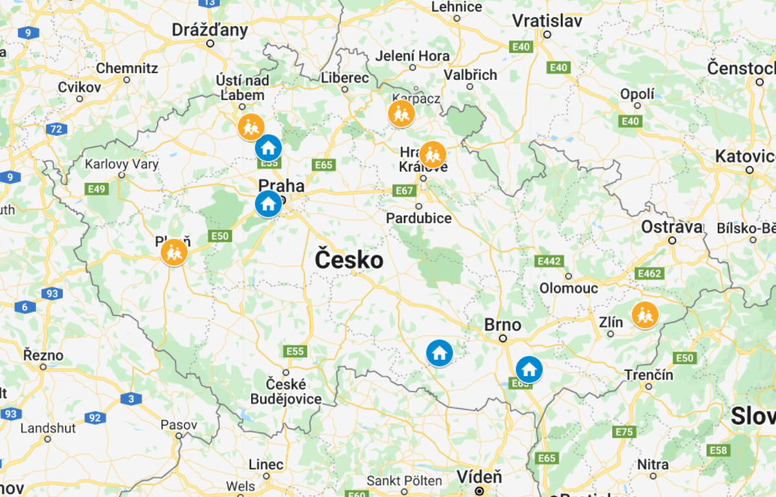
Diaconia ECCB and refugees coming to the Czech Republic
5 Diaconical Centers upscaling their social services 4 Diaconical Centers accommodating refugees
www.diakoniespolu.cz
20

Slide 21
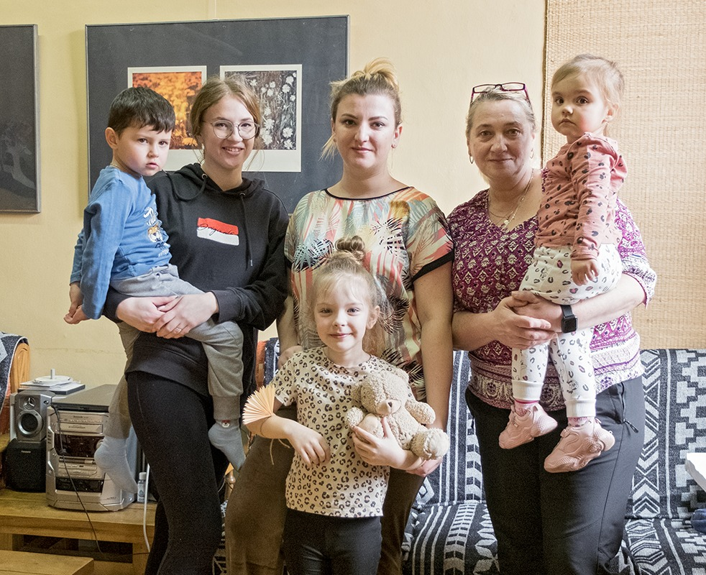
Diaconia ECCB and refugees coming to the Czech Republic
Children‘s clubs
SAS – Social Activation Service
for families
Low treshold youth clubs
Czech language courses
Summer camps
www.diakoniespolu.cz
21

Slide 22
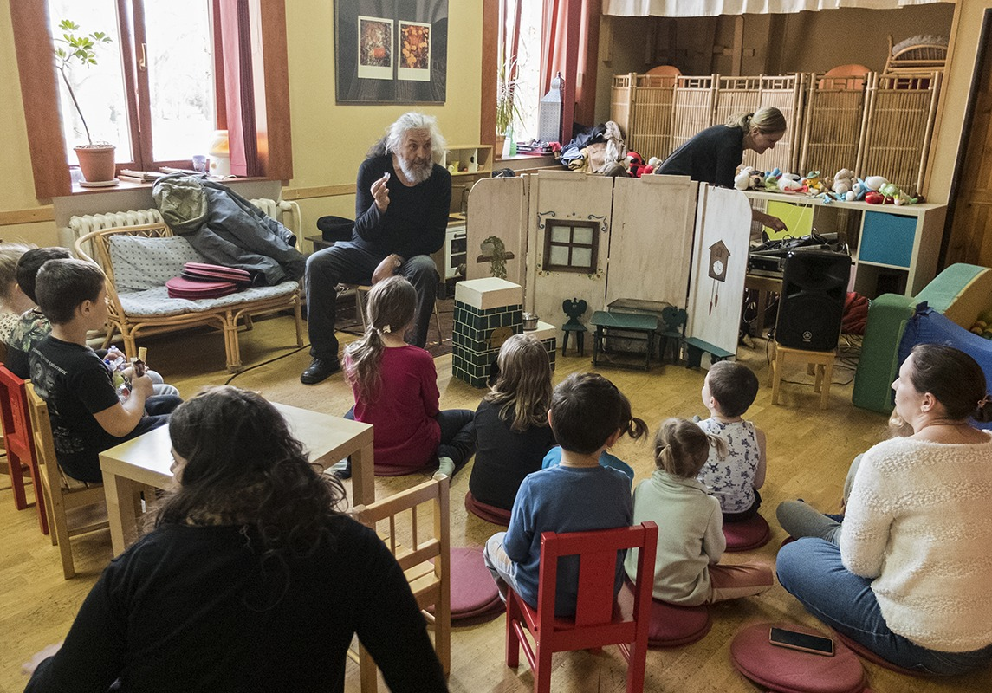
Diaconia ECCB and refugees coming to the Czech Republic
Children‘s club – Diaconia Litoměřice
www.diakoniespolu.cz
22

Slide 23
Diaconia Litoměřice – program of social rehabilitation – job search support
www.diakoniespolu.cz
23

Slide 24
“
“
Thank you!
ambrozova@diakoniespolu.cz
www.diakoniespolu.cz

