Slide 1
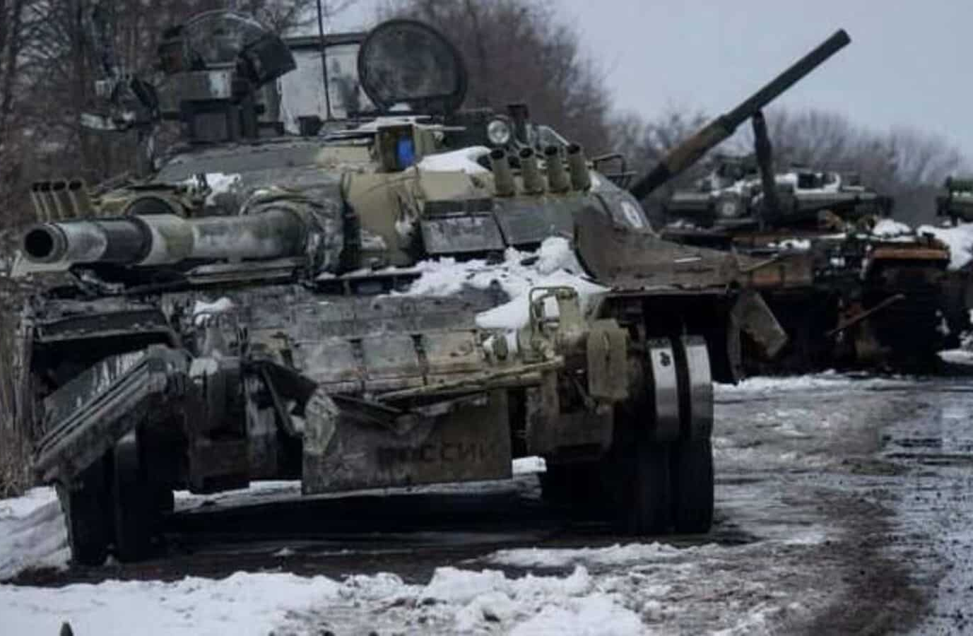
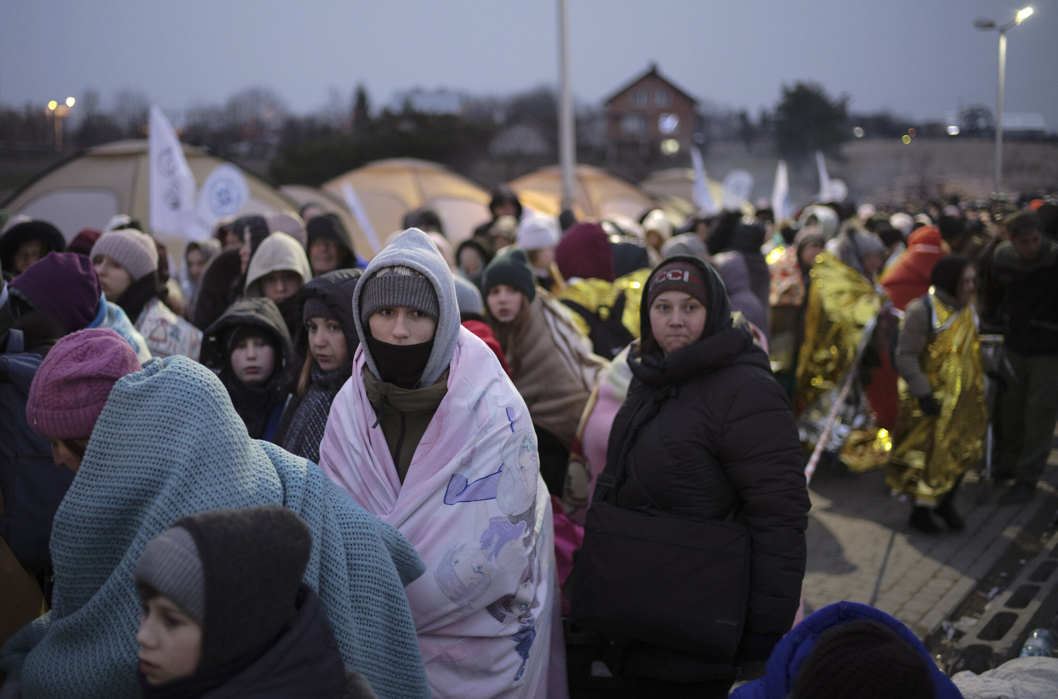
Together for Ukraine
A gathering of members of the Presbyterian Church (USA) and the Evangelical Church of the Czech Brethren during a time of crisis

Slide 2
Ways to Support Ukraine:
Presbyterian Church Mission and Presbyterian Disaster Assistance:
https://pma.pcusa.org/donate/make-a-gift/gift-info/DR000156/?appeal=PDA&package=UK22-PNS
This Child Here:
http://www.thischildhere.org
The Diakonie’s Lent Collection:
https://postnisbirka.diakonie.cz/
Account 2400384700/2010. VS for Ukraine is 2547
The ECCB’s Social and Charitable Assistance Fund:
https://e-cirkev.cz/en/ukraine/
Account 7171717171/2700

