Slide 1
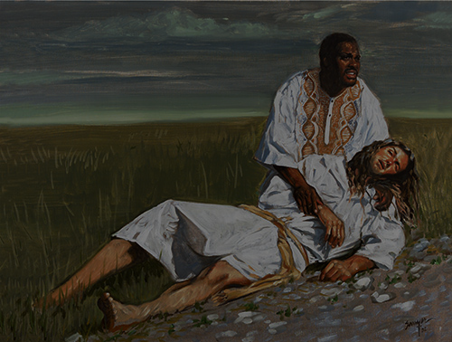
Christianity, Refugees, and Samaritans
Mark Douglas
Professor of Ethics
Columbia Theological Seminary

Slide 2
Two big themes:
The centrality of refugees to the Christian faith
The obligations of neighbor-love for shaping engagements with refugees

Slide 3
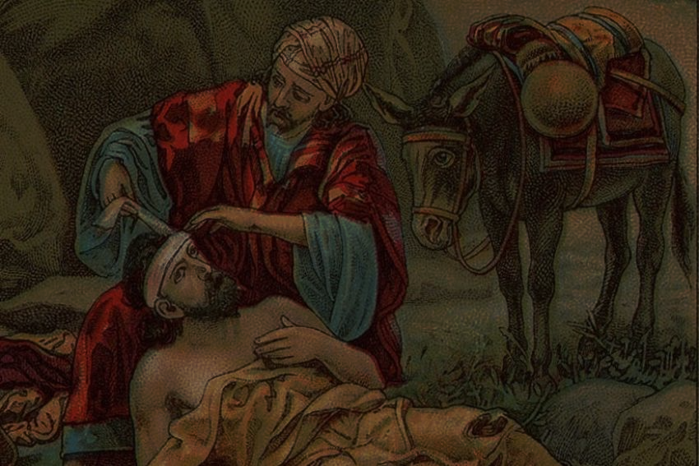
I. The centrality of refugees to the Christian faith
(Some of the) refugees in our narrative:
Adam and Eve
Noah
Abram (multiple times)
Jacob
Joseph
The Israelites of Exodus
Ruth
The Hebrew people during exile
Jesus
The early church
Augustine
(etc.)
Jan Huss
John Calvin
(Some of the) commands about the treatment of refugees in scripture:
Exodus 23:9
Leviticus 19:34
Isaiah 16:4
Jeremiah 7:5-7
Matthew 25:35
Romans 12:13
Ephesians 2:19
Hebrews 13:1-2
A big idea to carry forward:
We should all experience our lives in the faith, at least in part, as refugee lives.

Slide 4
II. The obligations of neighbor-love for engaging refugees
Who is my neighbor?
Complicated question: Russians (inc. Putin) also neighbors
Answer not bounded by “those like us” or “those we agree with”
Call to discern the image of God in the other: to love the neighbor is a way to express our love for God and to recognize that we share something with that other in the life and love of God.
Jesus’s question, “How to be a neighbor?”
What is the import of the parable of the Good Samaritan?
What if the victim asks for things you don’t want to give: needs and desires.
What if you’ve been mugged before because you helped: history vs. obligation.
What if you come upon the man being mugged: behaving violently as an act of love.
What if you come upon another person in the ditch: distributing love among many.
Why love these particular neighbors?
Answer, in part, by attending to centrality of refugees to the faith.
Answer, in part, by recognizing that we are called, especially, to care for particular neighbors based on their need.
Answer, in part, by recognizing that (1) and (2) are related.
How do I love these particular neighbors?
Address basic needs: safety, shelter, food, water.
Help them create a neighborhood: respect for their values and perspectives; pursue shaping larger systems for education, space for their rituals, promoting their voices in public/political settings

