Slide 1
March 2022: 800 refugees in 130 congregations
Martin Balcar (balcar@e-cirkev.cz)

Slide 2
How it started?
23 February (day before) – request for „beds“ in local churches
25 February (day after) – 46 local churches involved
Now: 130 local churches with 800 people

Slide 3
What we do?
Accommodation (800 people)
Community work
Teaching of the Czech language
Co-operation with Diaconia
Assistance
Work, health, school…
99% volunteers

Slide 4
What we need?
Church is not recognized as an eligible „host community“ (covering running costs) = lobbying
Teachers, social services = professionals
Money to cover running costs, paying professionals and buying equipment = development
…but the movement is a „miracle“ ☺

Slide 5
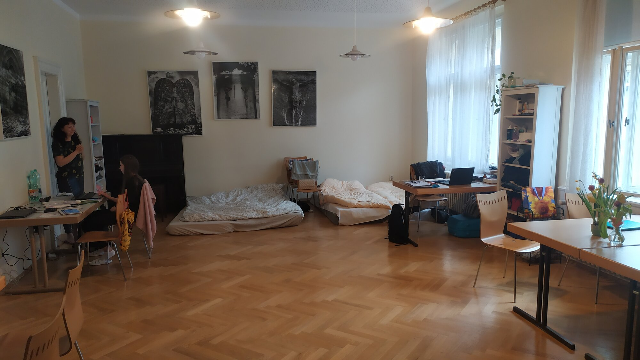
Prague - Kliment
10 people, helping with insurance company, bank, embassy, labor office
Starting with teaching Czech

Slide 6
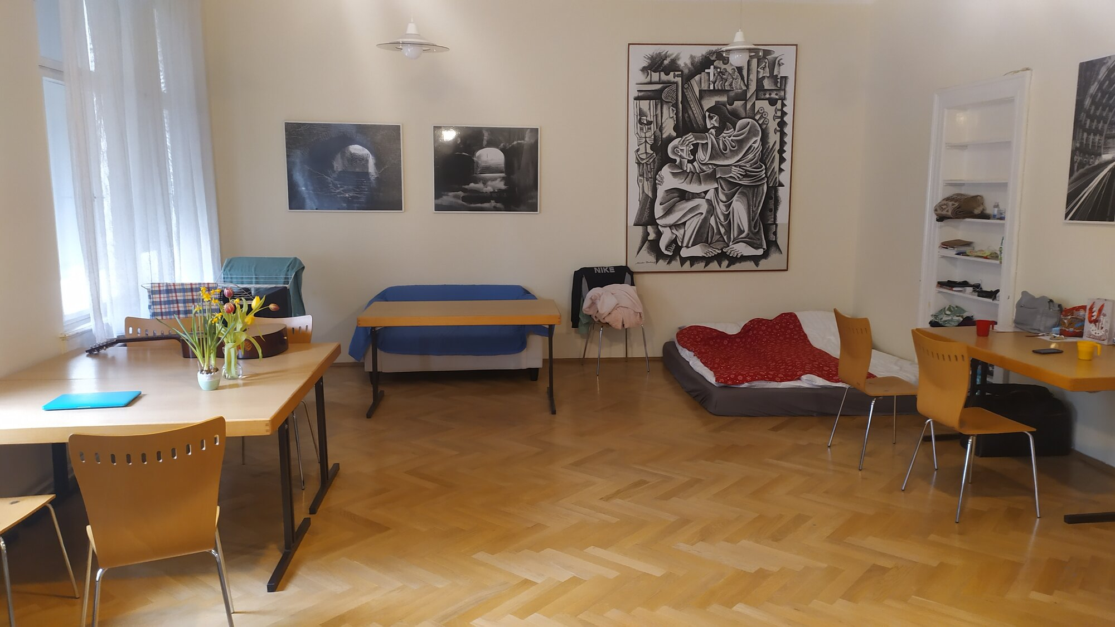
Prague - Kliment
10 people, helping with insurance company, bank, embassy, labor office
Starting with teaching Czech

Slide 7
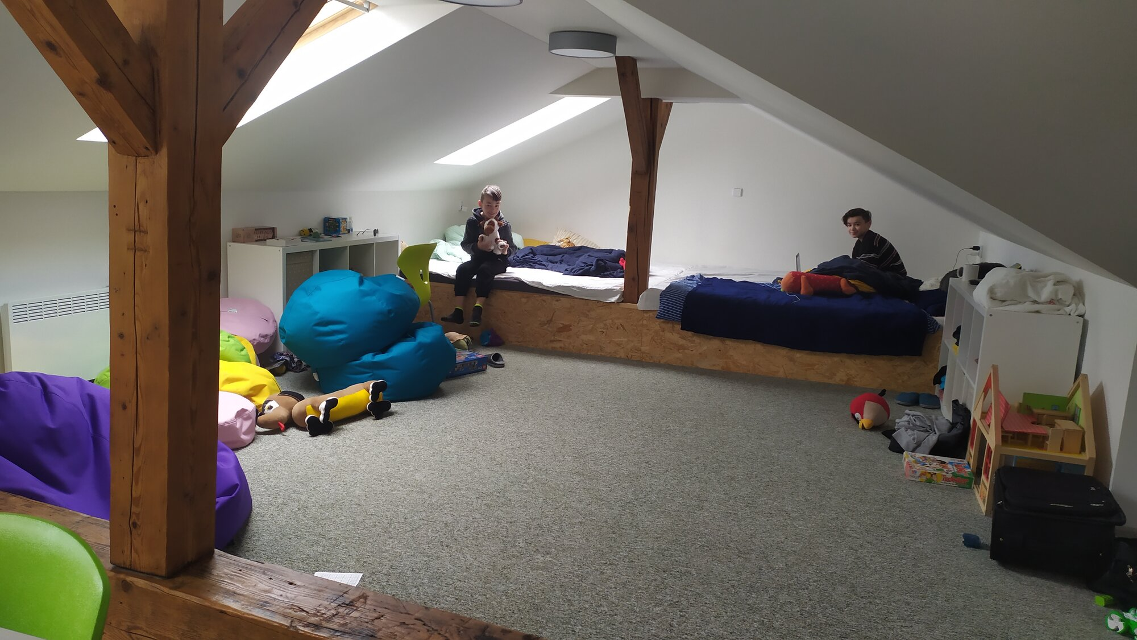
Prague - Kliment
10 people, helping with insurance company, bank, embassy, labor office
Starting with teaching Czech

Slide 8
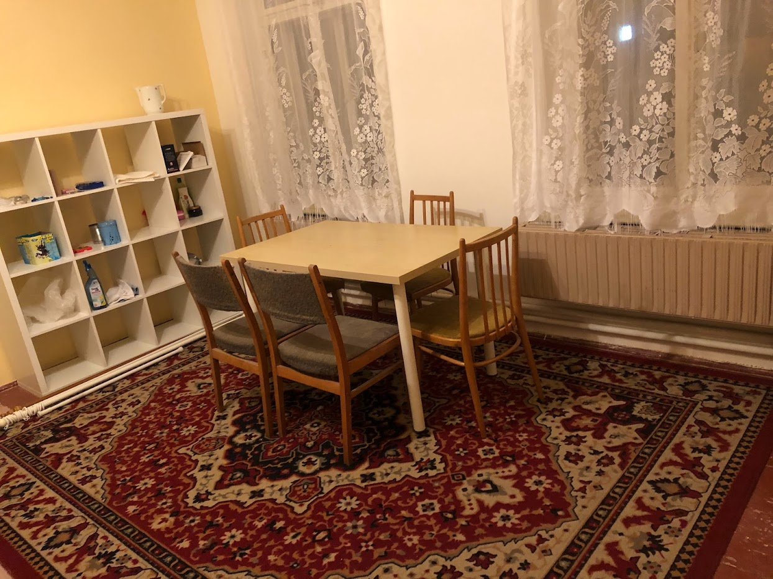
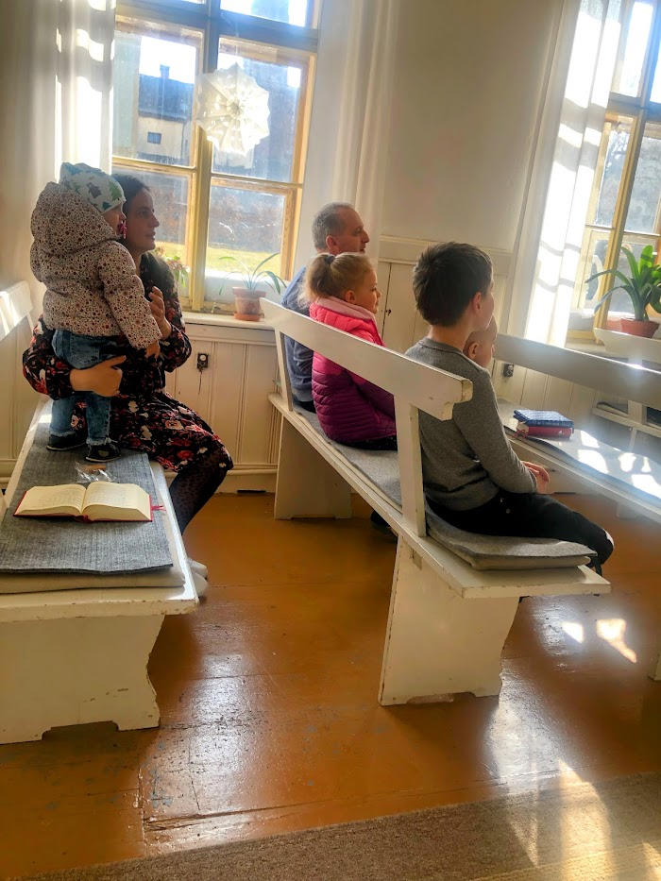
Jablonec
7 people accommodated, helping with school

Slide 9
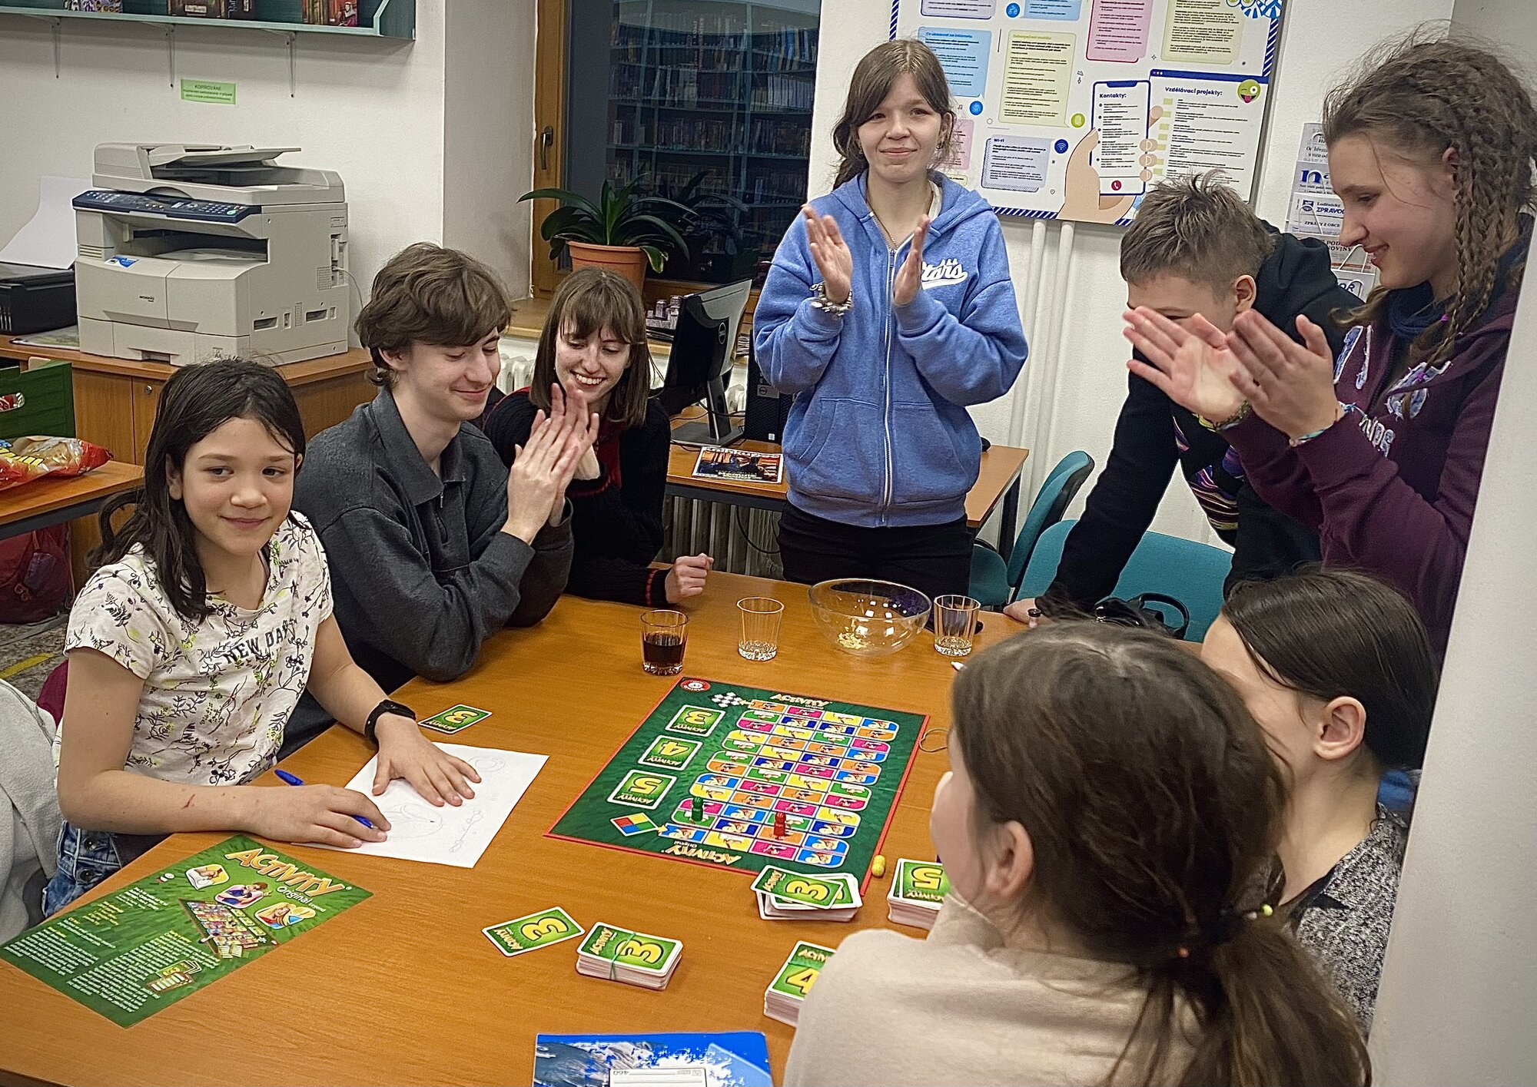
Beroun
3 families accommodated, group of young people meeting at the parish
Humanitarian aid from the congregation

Slide 10
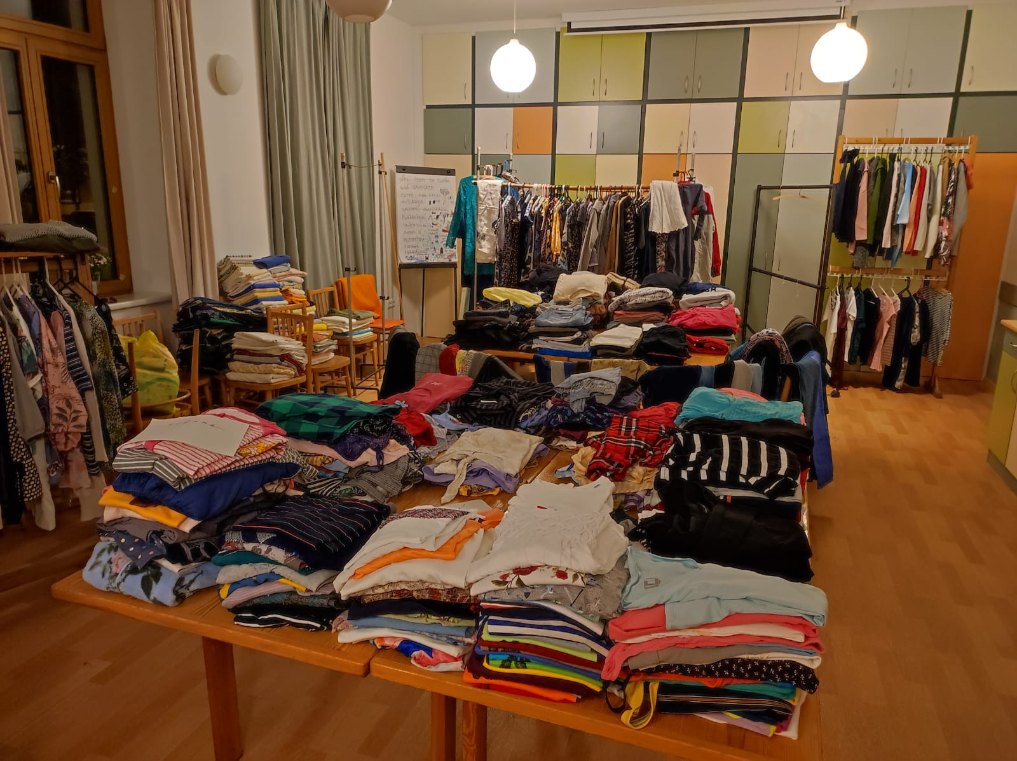
Pardubice
flea market – mostly clothes, people accommodated in families
Local church used as „community center for mothers“

Slide 11
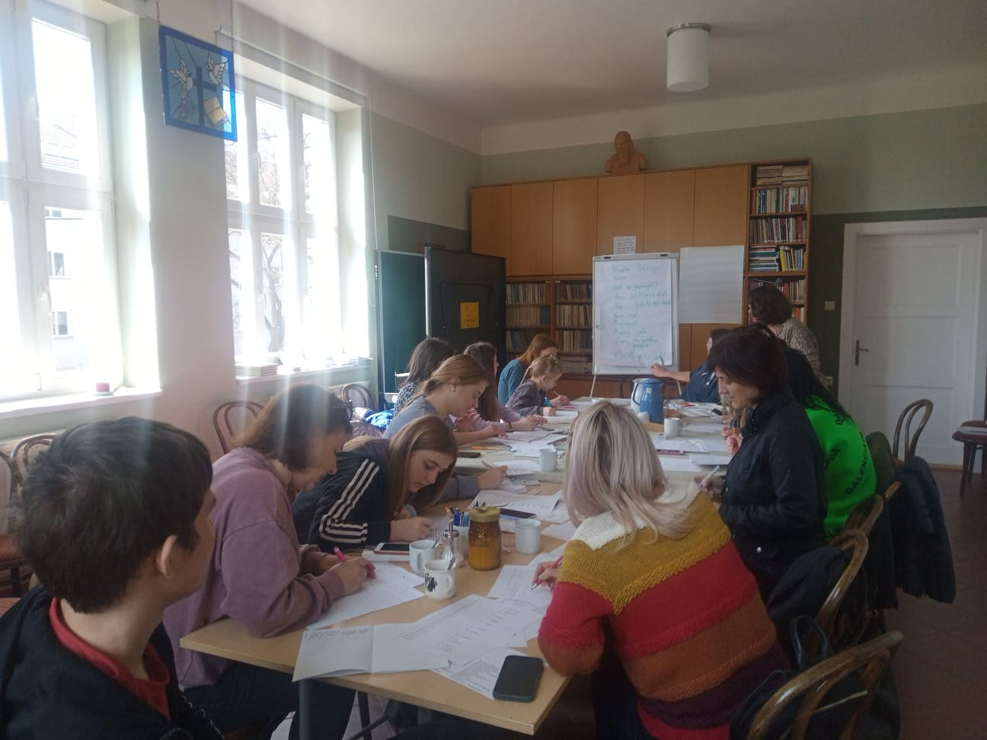
Velké Meziříčí
Accommodated families, Czech courses, financial help

Slide 12
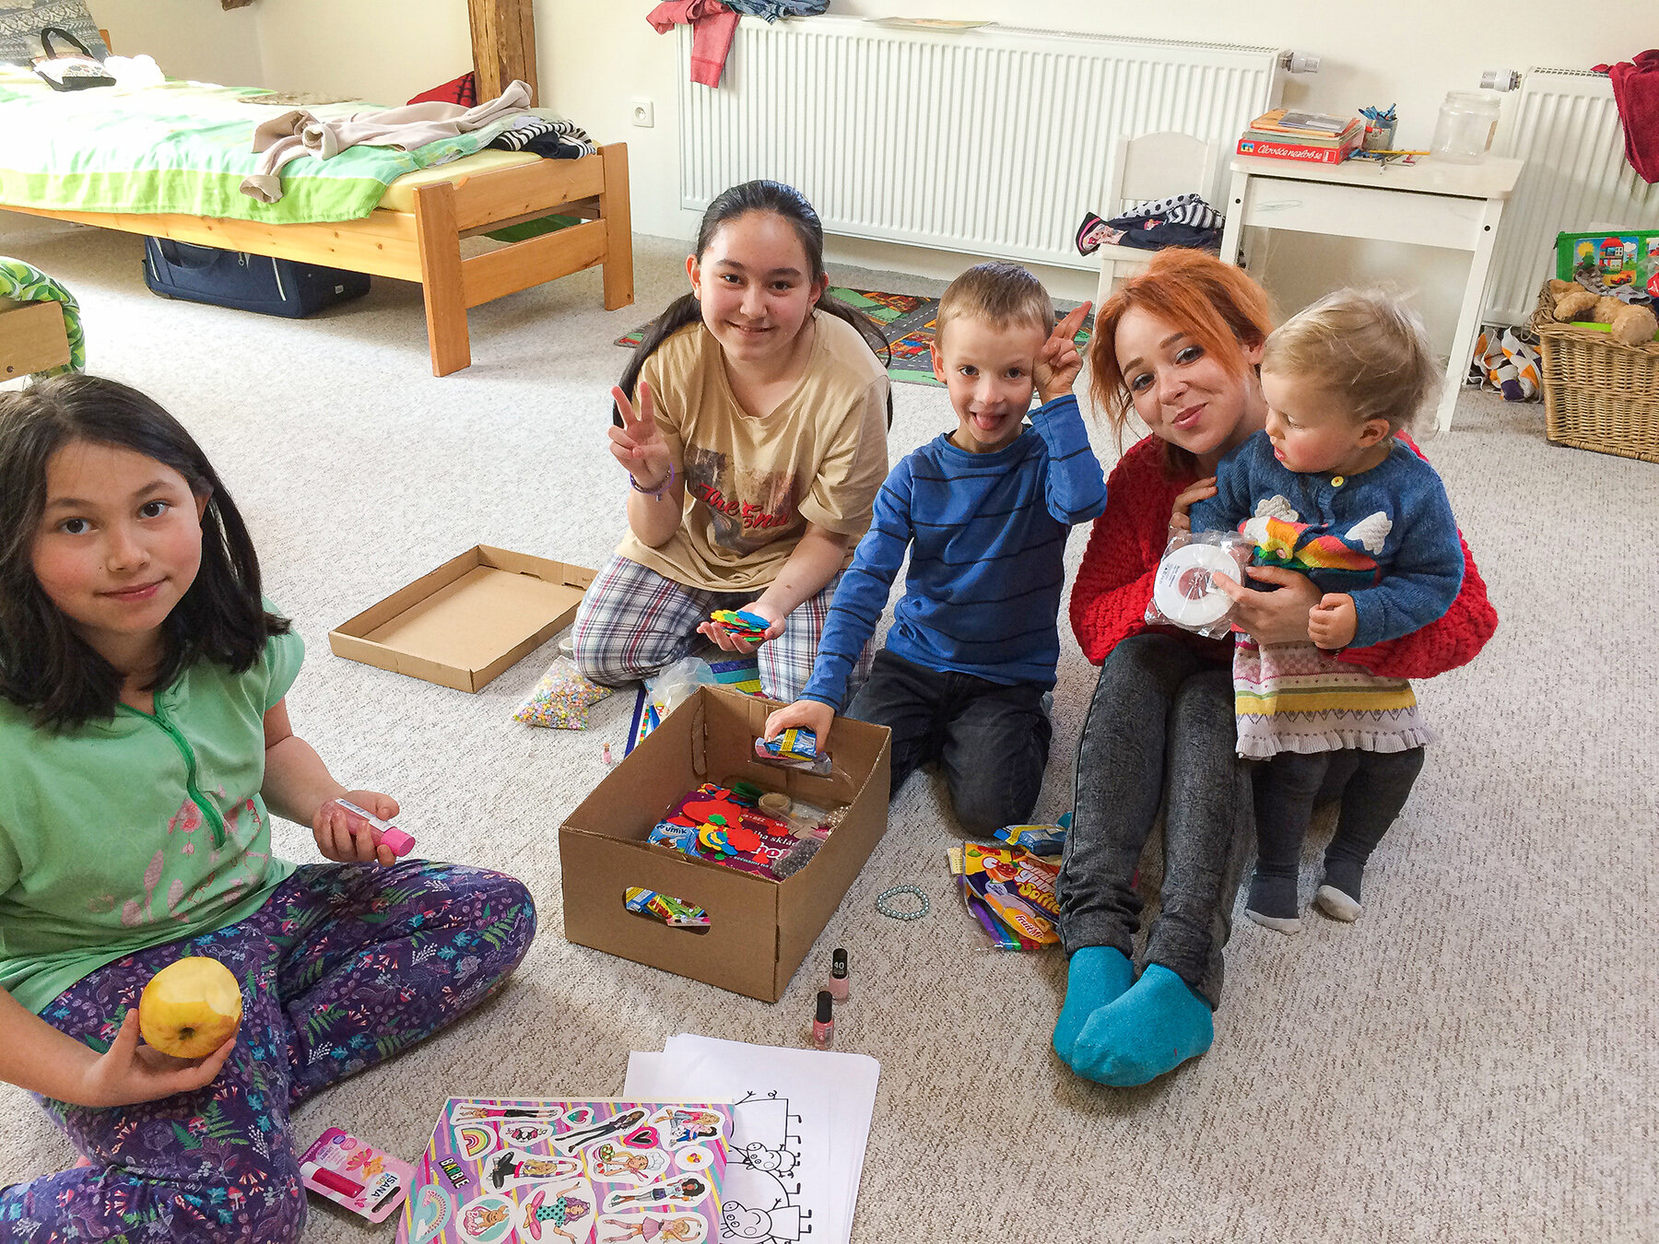
Brno - Husovice
Accommodation in families for 20 people

Slide 13
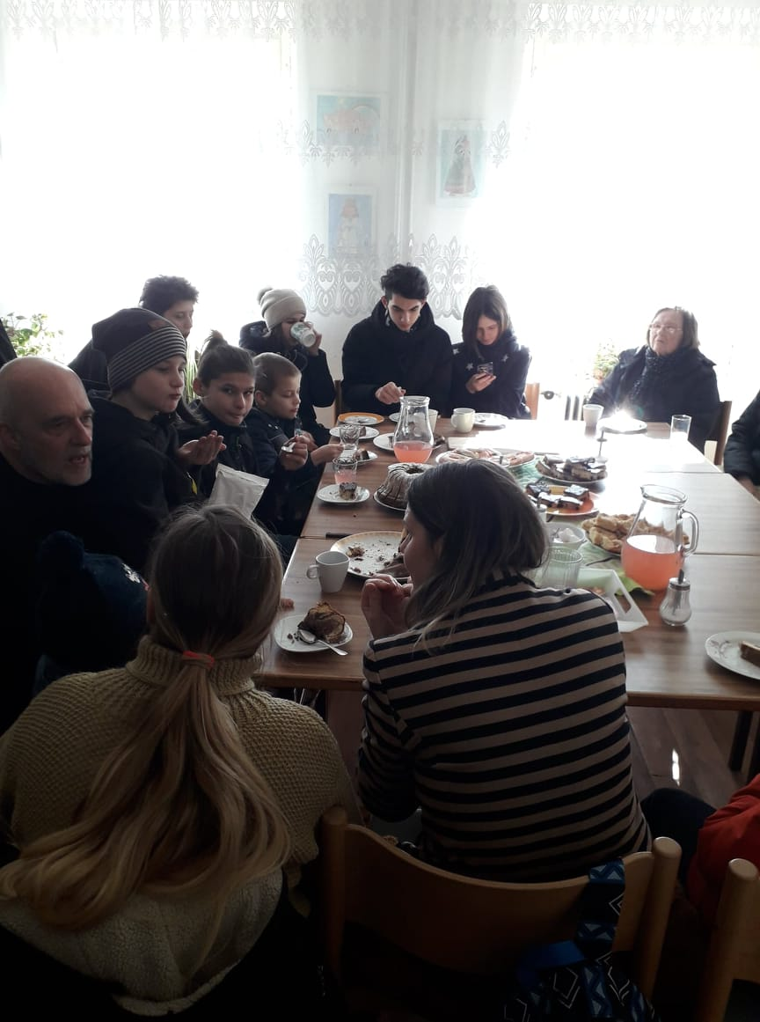
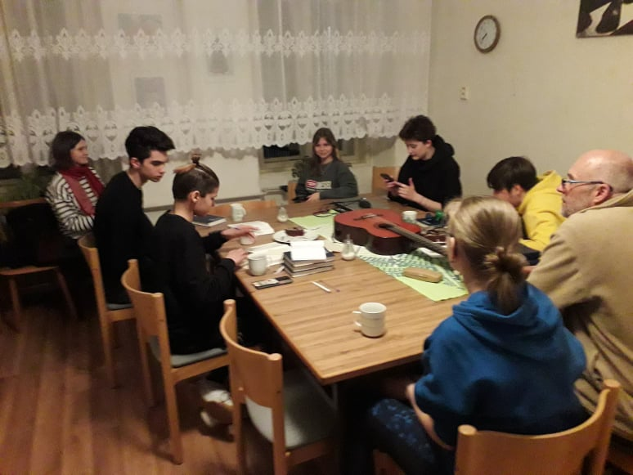
Horní Dubenky
Many courses of the Czech language, church space used as online office for workers (HUB), common worship, meeting point - community center

Slide 14
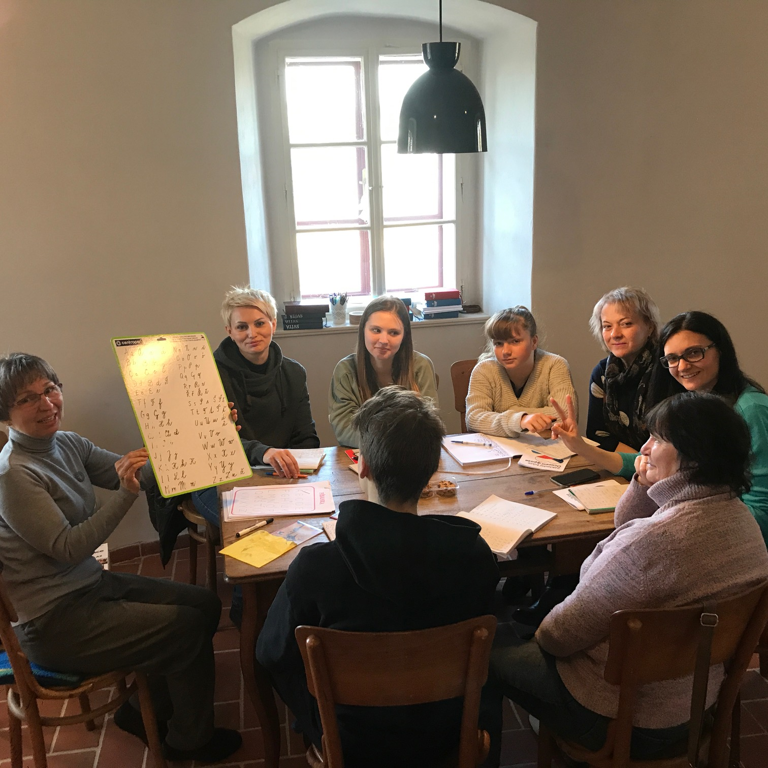
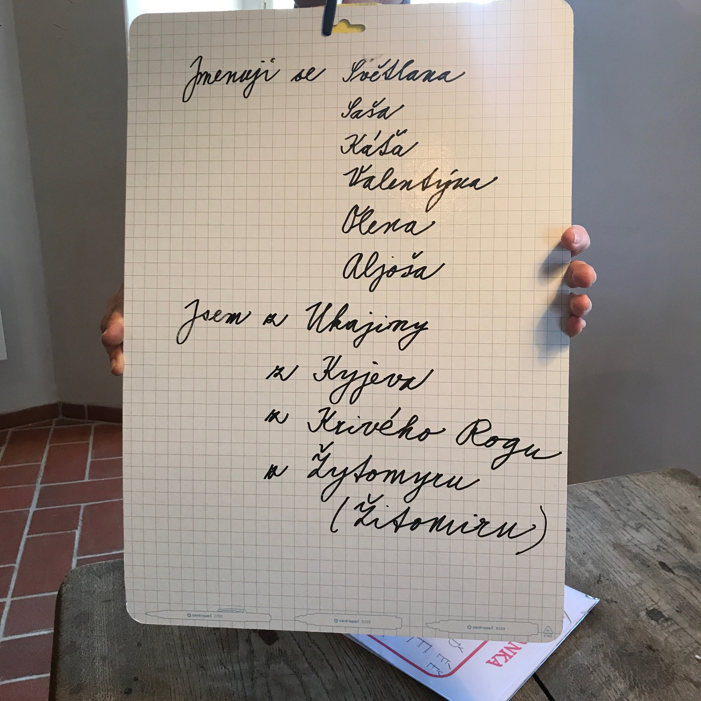
Čáslav
Accommodation in Diaconia and in families from the congregation
Clubs for children, mush-up breakfasts, plan to open a „cafe“

Slide 15
Thank you for your help!

